Slide 1

RYANA CALENDARS
MADE BY: ARSHMAAN AHMED

Slide 2

Problem statement
RYANA CALENDERS is a website were you can find different types of stationery items(e.g. Calendars, diaries, and etc.) where people will get all the information about the various products available with them easily.
RYANA CALENDARS is selling various Calendars and Diary products. The company advertises by distributing the pamphlets, advertising on television and so on.

Slide 3
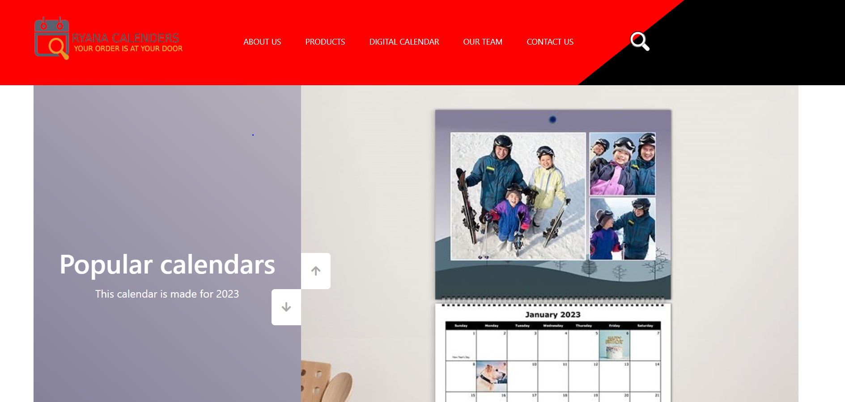


SCREEN-shots

Slide 4
Products available
PRODUCTS AVAILABLE
CALENDARS
DIARIES
PENS
PENCILS
STORYBOOKS
NOTEBOOKS
ACCESSORIES

Slide 5

Thank you
NAME:
ARSHMAAN AHMED
GMAIL:
arshmaan.aptech16@gmail.com

